Slide 1
Dr.Noora A.Awad
MSc. Ph.D.
Clinical Biochemistry

Slide 5
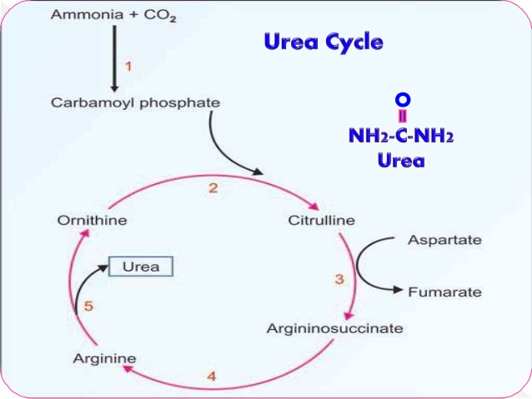

Slide 8
